Slide 1
Chapter 5. Macroscopic symmetry of crystals
Concept of symmetry
Characteristic of crystal symmetry
Elements and operations of crystal symmetry
Combination of symmetry elements
Symmetric type and its derivation
Symmetry classification of crystals
Symmetry symbols of point group
Classification of quasicrystals
Notes:
宏观对称性的数学描述晶体的对称性有宏观对称性和微观对称性之分, 前者指晶体的外形对称性,后者指晶体微观结构的对称性。

Slide 2

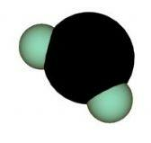
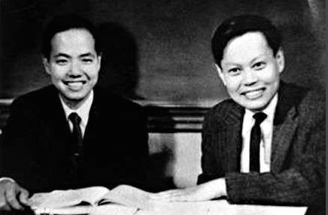
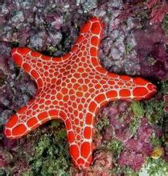




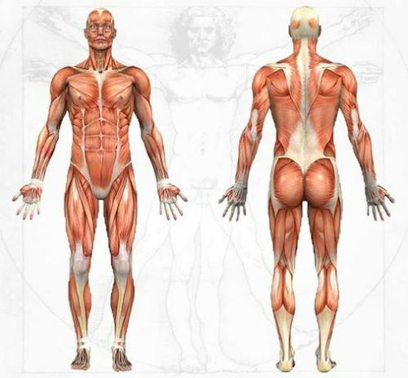
1. Concept of symmetry
Crystallography
General phenomena in universe
Most general and basic concept of natural science
Code for nature
Permanent aesthetic element
Parity Nonconservation
Notes:
http://blog.sina.com.cn/s/blog_53205e4201009kun.html
简单说，宇称就是一种空间的左右对称。在物理学中，这种“对称性”就是指物理规律在某种变化下的不变性。例如，在实验室做某一实验，你无论是今天做还是明天做，无论是今年做，还是10年以后做，只要实验条件没有改变，所得的实验结果都应是一样的。同样，同一个物理实验，你无论放到哪一个实验室去做，都应该得出一样的实验结果。总之，时间和空间的变化，不会改变物理规律的形式和结果。
在量子力学里，宇称，是表征微观粒子运动特性的物理量。宇称守恒定律是关于微观粒子体系的运动或变化规律具有左右对称性的定律。即微观粒子体系在发生某种变化过程（如核反应、基本粒子的产生和衰变等）前的总宇称（其值为+1或-1）必须等于变化过程后的总宇称。其物理意义是，粒子体系和它的“镜像粒子”体系都遵从同样的运动变化规律。
宇称守恒定律与许多实验结果相符合，原本是物理学界一致相信的原理之一，曾为人们所公认。尽管由于θ与τ粒子在实验中所显现出的矛盾现象，引起了人们对宇称守恒定律的怀疑，但要推倒这棵大树简直太难了，大多数人都望而却步。直到1956年，李政道和杨振宁根据对实验事实的分析，首先从理论上指出，并由吴健雄等人在实验中证实，至少在基本粒子弱相互作用的领域内，宇称并不守恒。从而证明，宇称守恒定律并不普遍适用。
在相当长的一段时间内，物理学家们相信，所有自然规律在这样的镜象反演下都保持不变!
宇称守恒是指在任何情况下,任何粒子的镜象与该粒子除自旋方向外,具有完全相同的性质.
宇称不守恒定律是指在弱相互作用中,互为镜像的物质的运动不对称.
吴健雄用两套实验装置观测钴60的衰变，她在极低温(0.01K)下用强磁场把一套装置中的钴60原子核自旋方向转向左旋，把另一套装置中的钴60原子核自旋方向转向右旋，这两套装置中的钴60互为镜像。实验结果表明，这两套装置中的钴60放射出来的电子数有很大差异，而且电子放射的方向也不能互相对称。实验结果证实了弱相互作用中的宇称不守恒。
对称性反映不同物质形态在运动中的共性，而对称性的破坏才使它们显示出各自的特性。如同图案一样，只有对称没有它的破坏，看上去虽然很规则，但同时显得单调和呆板。只有基本上对称而又不完全对称才构成美的建筑和图案。大自然正是这样的建筑师。当大自然构造像DNA这样的大分子时，总是遵循复制的原则，将分子按照对称的螺旋结构联接在一起，而构成螺旋形结构的空间排列是全同的。但是在复制过程中，对精确对称性的细微的偏离就会在大分子单位的排列次序上产生新的可能性，从而使得那些更便于复制的样式更快地发展，形成了发育的过程。

Slide 3
Parity Nonconservation
In quite a long period of time, physicists believed that all the laws of nature are unchanged in the mirror inversion!
Parity conservation refers to in any case, the image of any particles, has exactly the same properties with the particles except the direction of their spin.
The law of parity nonconservation refers to that in the weak interaction, the movement is asymmetry for mutual mirrored materials.
Notes:
基本概述
宇称不守恒定律是指：在弱相互作用中，互为镜像的物质的运动不对称，由吴健雄用钴60验证。
科学界在1956年前一直认为宇称守恒，也就是说一个粒子的镜像与其本身性质完全相同。
1956年，科学家发现θ和τ两种介子的自旋、质量、寿命、电荷等完全相同，多数人认为它们是同一种粒子，但θ介子衰变时产生两个π介子，τ子衰变时产生3个，这又说明它们是不同种粒子。
深入研究
1956年，李政道和杨振宁在深入细致地研究了各种因素之后，大胆地断言：τ和θ是完全相同的同一种粒子(后来被称为K介子)，但在弱相互作用的环境中，它们的运动规律却不一定完全相同，通俗地说，这两个相同的粒子如果互相照镜子的话，它们的衰变方式在镜子里和镜子外居然不一样！用科学语言来说，“θ-τ”粒子在弱相互作用下是宇称不守恒的。

Slide 4
Parity Nonconservation
Mrs. Wu Jianxiong observed the decay of cobalt 60 with two sets of experimental devices. She used a strong magnetic field at a very low temperature (0.01K) to turn the spin direction of the cobalt 60 nucleus in a set of devices to the left, and the spin direction of cobalt 60 nucleus in another set is turned to the right. The cobalt 60 in these two sets of equipments are mirror images of each other. Experimental results showed that the cobalt 60 in the two sets of devices emitted the number of electrons are quite different, and the direction of electron emission can not be symmetrical with each other. The experimental results confirm that the parity is not conserved in the weak interaction.

Slide 5
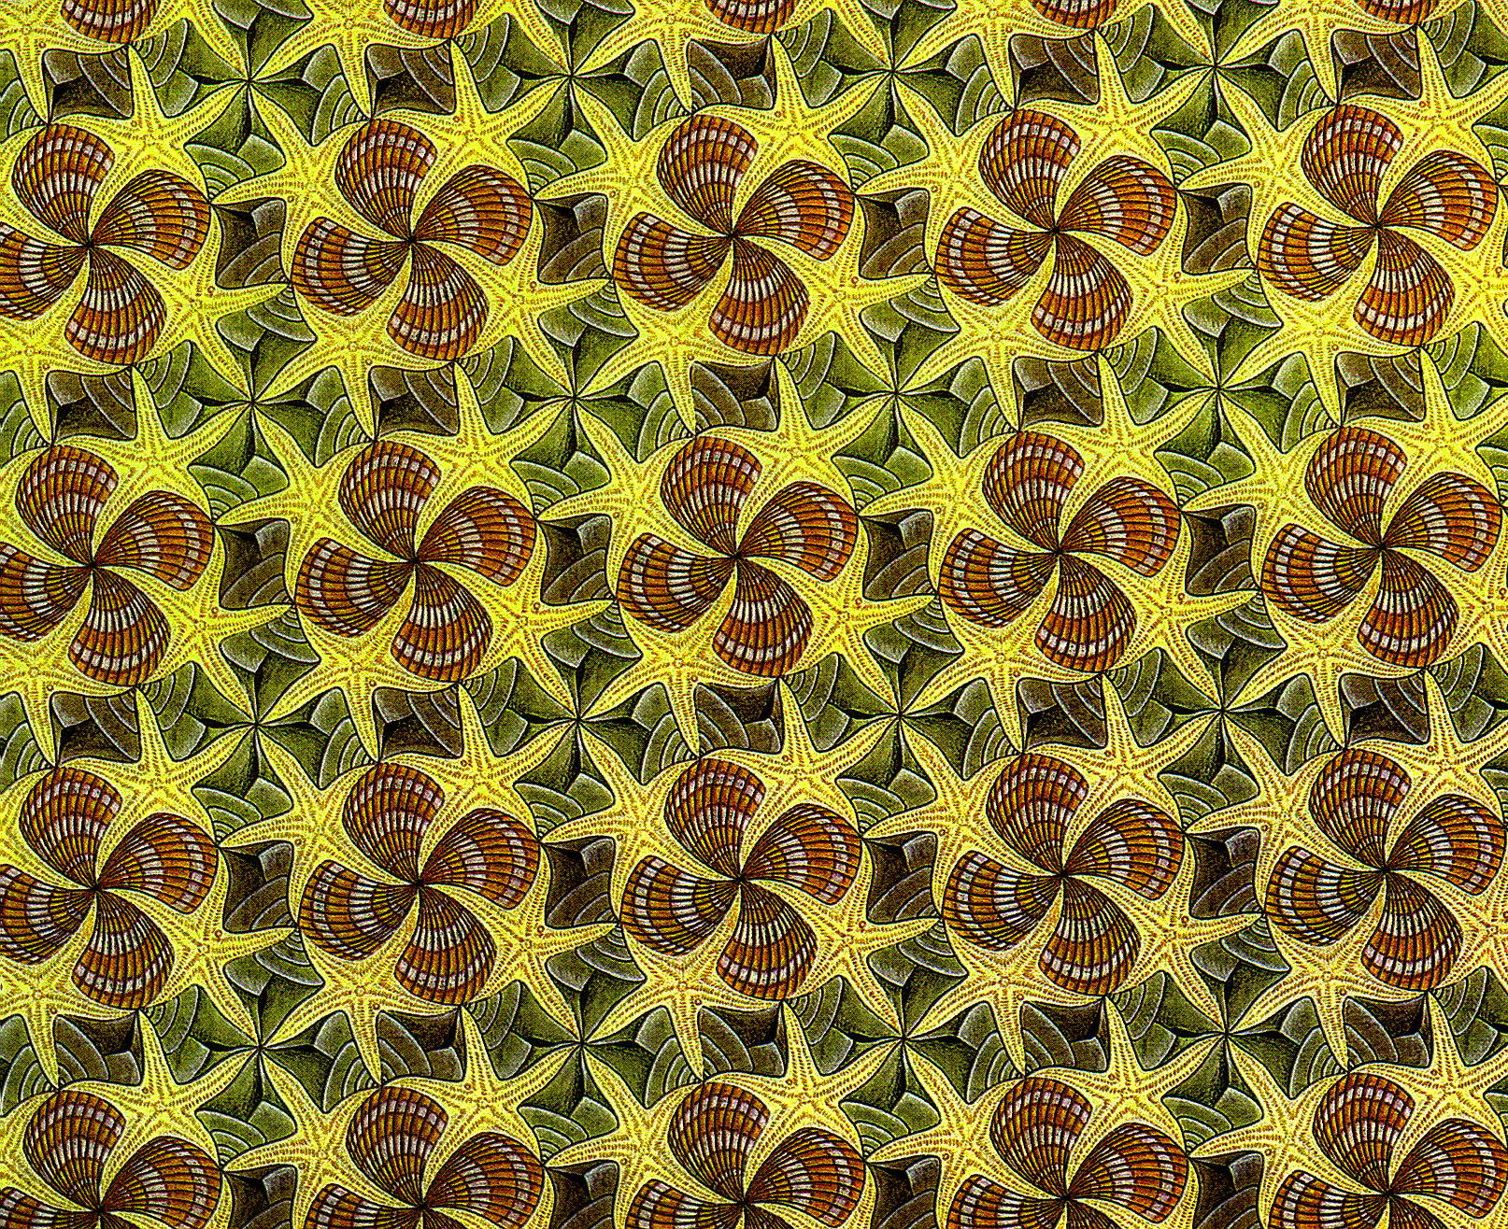


Crystallography
Concept of Symmetry
The same parts in the object (or graphics) are regularly repeated.

Slide 6
2.Character of crystal symmetry
Crystallography
Since the interior of crystals has a lattice structure, the same particles can be repeated by translation, so that all the crystal structures are symmetrical.
The symmetry of crystals is limited by the lattice structure, so the symmetry of the crystal is finite, and it follows "crystal symmetry law".
Crystal symmetry is not only reflected in shape, but also reflected in physical properties.
The lattice structure makes all the crystals symmetrical, and the lattice structure also makes it impossible for all symmetries to appear in crystals.
Notes:
平移不变性 translation invariance

Slide 7
symmetry operation (对称操作)
Crystallography
3. Macroscopic symmetry element and symmetry operation in crystal
能够使对称物体(或图形)中的等同部分作有规律重复的变换动作(对称操作)
some acts that reproduce the motif to create the pattern
Motif：the fundamental part of a symmetric design that, when repeated, creates the whole pattern

Slide 8
Symmetry element
Crystallography
Symmetry element：The auxiliary geometric elements (辅助几何元素) - points, lines, faces, etc., which are used for symmetry operations.
Classification of symmetry elements
Symmetry center (对称中心)
Symmetry axis (对称轴)
Symmetry plane (对称面)
Rotoinversion axis (旋转反伸轴)
Rotoreflection axis (旋转反映轴)
Symbols of symmetry elements

Slide 9
Symbol of symmetry elements
Crystallography
Symmetry elements of the compound
Symmetrical elements of macroscopic crystals
Element
Symmetry Axis （n）
Symmetry center
Symmetry plane
Rotoinversion axis
-
-
-
1
2
3
4
6
3
4
6
Auxiliary geometry
line
point
plane
Line and certain point on the line
Symmetry operation
Rotation about lines
Inversion about point
Reflection about plane
Rotation about the line and inversion about the point
Basic rotation
angle
Conventional sign
-
-
-
International sign
Equivalent element
Graphical symbol
Or
Double line or thick line
The possible symmetry elements existing in crystal morphologies and corresponding symmetry operations are introduced in the following slides:

Slide 10
Symmetry operations
Crystallography
Symmetry operation ＝ coordinate transformation
(x, y, z) (X, Y, Z)
or
Transformation matrix

Slide 11
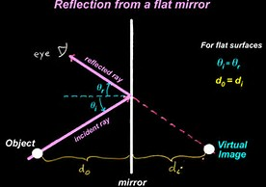

Crystallography
Mirror Planes
The operation for mirror planes—P is reflection. There could be many mirror planes, such as 3P、6P, etc.
Notes:
下发若干模型

Slide 12
Crystallography
Mirror Planes
Please find mirror planes on the crystal models above
Notes:
下发若干模型

Slide 13
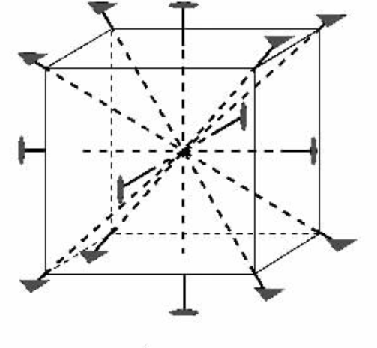
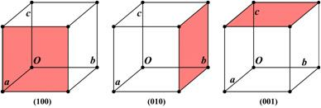
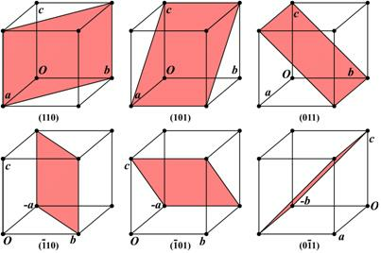
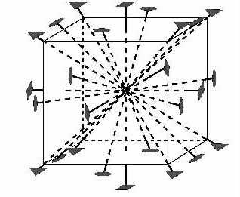
Symmetry element in cubic system 3L⁴4L³6L²9PC
3L⁴4L³
3L⁴4L³6L²
9P

Slide 14
Crystallography
Planar graphic presentation of
Symmetry operation for mirror plane
Mirror plane (对称面)
Reflection across a “mirror plane” reproduces a motif
= symbol for a mirror
m
Notes:
Planar graphic presentation

Slide 15
Crystallography
Symmetry operation of mirror planes (m)
Mirror plane (m)
Transformation matrix for m including x, y axises
Exercise I:
Please give the transformation matrix when m include x、z axis ? When m include y、z axis ?
How about when m at other places?

Slide 16
Crystallography
Symmetry axis
☆Symmetry axis—L^{n}
Operation is rotation. n (轴次) means the repeat times of the same part during 360°rotation. α is the minimum rotation angle that object overlaps with itself and is named as base rotation angle (基转角)，where：n = 360/α 。
A. a rotation symmetrical shape B. non-symmetrical shape
Notes:
各自在手中的模型中寻找

Slide 17
Crystallography
Symmetry axis
☆Symmetry axis—L^{n} ，n-fold rotation axis
L²
L⁴
L⁶
Notes:
各自在手中的模型中寻找

Slide 18
Crystallography
Symmetry operation of symmetric axis (L^{n})
symmetric axis
(two-fold rotation)
= 360º/2 rotation
to reproduce a motif in a symmetrical pattern
A Symmetrical Pattern
6
6

Slide 19
Crystallography
Symmetry operation of symmetric axis (L^{n})
symmetric axis
(two-fold rotation)
= 360º/2 rotation
to reproduce a motif in a symmetrical pattern
Operation
A Symmetrical Pattern
6
Motif
Element
6
= the symbol for a two-fold rotation

Slide 20
Crystallography
Symmetry operation of symmetric axis (L^{n})
symmetric axis
(two-fold rotation)
= 360º/2 rotation
to reproduce a motif in a symmetrical pattern
A Symmetrical Pattern
6
Motif
First step
Element
Second step
6
= the symbol for a two-fold rotation

Slide 21
Crystallography
Symmetry operation of symmetric axis (L^{n})
symmetric axis
transformation matrix of L^{n}
For
L²

Slide 22
Crystallography
Planar graphic presentation of symmetry operation for (L^{n})
(no 5-fold and > 6-fold for classic crystal concept)
6
6
6
6
6
6
6
6
6
6
6
6
6
6
6
6
1-fold
2-fold
3-fold
4-fold
6-fold
Transformation matrix：
Notes:
此时alpha是实际的转角，而不是基转角。

Slide 23
Crystallography
Exercise:
Please derive all the transformation matrixes for L⁶.
Notes:
此时alpha是实际的转角，而不是基转角。

Slide 24
Crystallographic restriction theorem
Crystallography
Since crystals are solid substances with lattice structures, this internal property determines that the rotation axis (n) in crystals can only occur one, twice, three, four and six fold.
Five fold and more than six fold rotation axis are forbidden.

Slide 25
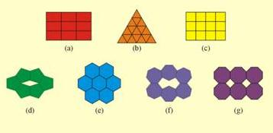
Crystallographic restriction theorem
Crystallography
Why？
1.Intuitive image understanding:
The plane motif with five or more than six fold rotation symmetry can not cover the entire space, and thus can not form crystal structures.

Slide 26
Crystallographic restriction theorem
Crystallography
2、Proof in math way：
A_{1、}A_{2、}A_{3、}A_{4、}are lattice points with distance a;
A_{1、}A₄ rotate around A₂、A₃ with α and overlap with B_{1、}B₂;
B₁B₂ = ma, m is an integer;
a + 2a cosα = ma
-1≤ cosα = (m-1)/2 ≤ 1
m = 3, 2, 1, 0, -1
a = 0, 60, 90, 120, 180
n = 1, 6, 4, 3, 2
(but，5、8、10、12 fold axis is allowed in quasi-crystal)
Rule of lattice

Slide 27
C is only located at crystal center. The operation is inversion.
Crystallography
Symmetry center - c
In crystals with symmetry center, crystal planes are always present in pairs and reversely parallel with same shape and size.
Notes:
反伸和2次旋转操作

Slide 28
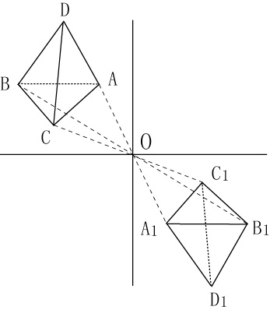
Crystallography
Operation of symmetry center
symmetry center (C, 1)
inversion according to an imaginary geometric point
(x, y, z) (-x, -y, -z)
Transformation matrix：

Slide 29
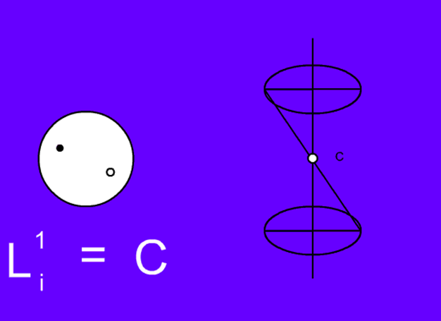
Crystallography
Rotoinversion axis（旋转反伸轴、倒转轴、反轴或反演轴）
☆ Rotoinversion axis – L_{i}^{n}
Operation: rotation + inversion
Stereographic projection
L_{i}¹=C
L_{i}²=P
Symmetry center locates at rotation axis

Slide 30
Crystallography
L_{i}³=L³+C
L_{i}⁴
L_{i}⁶=L³+P

Slide 31
Crystallography
Operation of Rotoinversion axis (L_{i}^{n})
Rotoinversion axis
Rotate around a line and inverse around a point
= symmetry axis＋symmetry center
Transformation matrix：
Type
L_{i}¹ = C
L_{i}² = P
L_{i}³ = L³ +C
L_{i}⁴
L_{i}⁶ = L³ +P

Slide 32
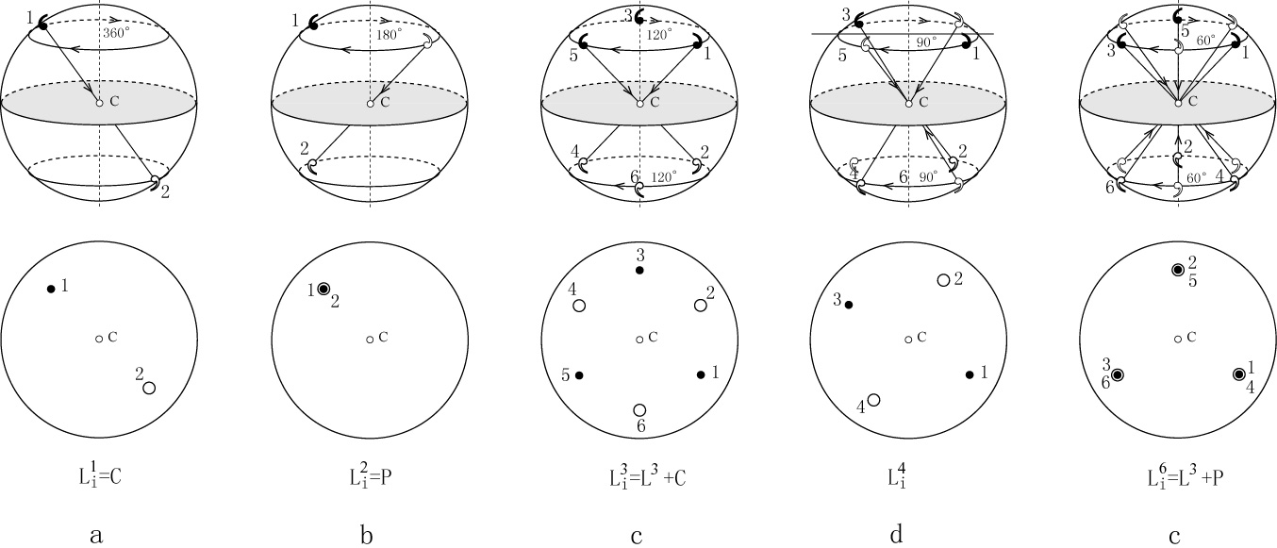
Crystallography
Planar graphic of operation for rotoinversion axis (L_{i}^{n})

Slide 33
Crystallography
Rotoinversion axis
Besides L_{i}⁴,other rotoinversion axis could be replaced by simple combination of symmetry elements：
L_{i}¹ = C， L_{i}² = P， L_{i}³ = L³ +C，L_{i}⁶ = L³ + P
But when we give symmetry elements of crystals, L_{i}⁴ and L_{i}⁶ are always applied, but others are replaced by simple elements. This is due to the irreplaceability of L_{i}⁴ and L_{i}⁶ has specific meaning in symmetry classification (refer to table 3-3 in text book ).
Notes:
倒转轴又称旋转反伸轴（rotoinversion axis）或反演轴(inversion axis)
（请同学们在模型上找L_{i}⁴ 和L_{i}⁶）

Slide 34
Crystallography
Rotoinversion axis
It is difficult to find L_{i}⁴ in crystal model, because it is similar with L² .
We can not replace L_{i}⁴ with L² as that we can not replace L² with L⁴.
This is because L⁴ is higher than于L² ， L_{i}⁴ is higher than L² . The highest symmetry element must be found when one hopes to find out the symmetry elements of crystals!
Notes:
**********
最后，请同学们找出几个模型上所有对称要素。

Slide 35
Rotoreflection axis （旋转反映轴、映转轴）
Crystallography
L_{s}²=C
L_{s}¹=P
Symmetry plane is perpendicular to rotation axis
L_{s}³=L³+P

Slide 36
Rotoreflection axis
Crystallography
L_{s}⁴=L_{i}⁴
L_{s}⁶=L³+C

Slide 37
Crystallography
Rotoreflection axis
The operation of rotoreflection axis and rotoinversion axis is the same at the effect.
They have the relations as below：
L_{i}¹=L_{s}²=C, L_{i}²=L_{s}¹=P,
L_{i}³=L_{s}⁶=L³+C, L_{i}⁴=L_{s}⁴, L_{i}⁶=L_{s}³=L³+P
Based on above relations, only rotoinversion is considered in practical work.
Notes:
**********
最后，请同学们找出几个模型上所有对称要素。

Slide 38
4. Combinations of symmetry elements
There are 8 basic symmetry elements, L¹, L², L³, L⁴, L⁶, C, P, L_{i}⁴. Their combinations form the point group of crystal.
The combination of symmetry element is not random. It must fulfill the combination law of symmetry element.
When symmetry elements coexist, new element may be formed.

Slide 39
Combination law of symmetry elements:
Crystallography
Theorem 1：L^{n}×L²⊥→L^{n}nL² (the angle between L²and L² is half of base angle of L^{n})
Converse theorem： when L² intersect with L², L^{n} will be generated at their joint point and it is perpendicular to L². The base angle is twice as much as the included angle of two L². And other L² at the plane perpendicular to L^{n} can be generated. (The angle of converse theorem is limited)
For example: L⁴×L²⊥→L⁴4L² , L³×L²⊥→L³3L²

Slide 40

Sample for Theorem 1： L⁴×L²⊥→L⁴4L²
Red: above plane
Grey: below plane
6
6
6
6
L²
6
6
6
6
L⁴
L⁴
L²
L²
L²
6
6
6
L²
6
L²
6
6
6
6
L²
L⁴
L⁴

Slide 41
Sample for converse theorem ： L² intersects with L² with 45°, then generates one L⁴, form 4 L² ， which are perpendicular to the L⁴.
6
6
L²
6
L²
6
6
6
L²
L²
L²
6
Red: above plane
Grey: below plane
6
L²
6
6
L²
L²
L⁴

Slide 42
Theorem of symmetry element combination：
Crystallography
Please give the symmetrical patterns to demonstrate the combination of symmetry elements below.
L³×L²⊥→L³3L²
Question:
When two L² intersect with 30°, which symmetry axis will be generated at their joint point and perpendicular to the plane of L²?
Notes:
L6

Slide 43
Exercise for Theorem 1：
L⁶×L²⊥ → ?
Exercise for converse theorem ：
When L² intersects with L² with 15°, which symmetry axis can be generated?
Please give the symmetrical patterns to demonstrate the combination of symmetry elements above.

Slide 44
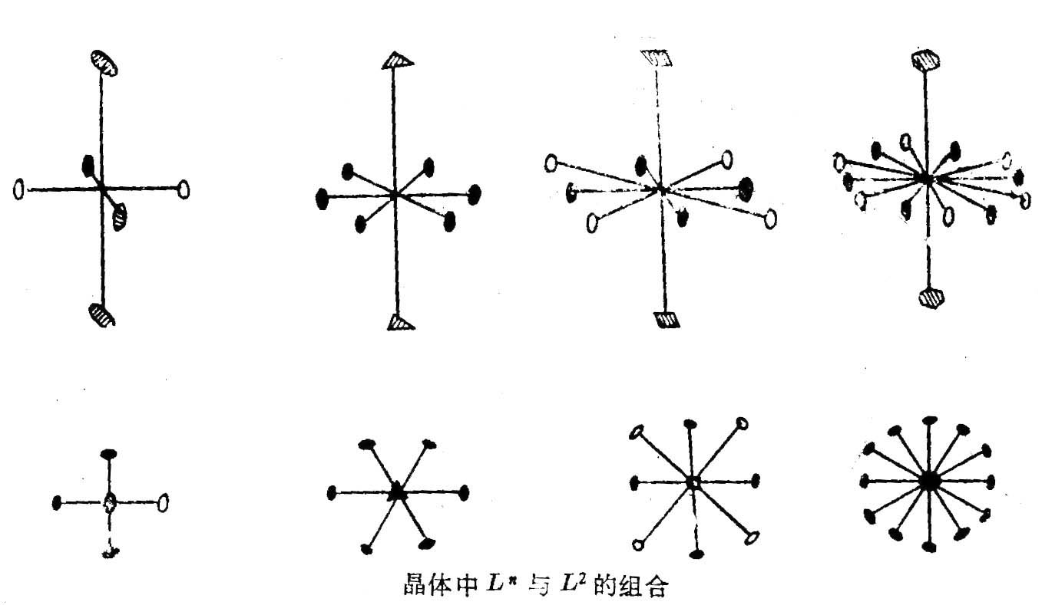
Combination of symmetry elements
Crystallography
Side
view
Top
view
Combination of L^{n} and L²
The solid signs are initial L² or generated by the operation of L² and L^{n}. The hollow signs are newly generated.

Slide 45
Theorem of symmetry element combination
Crystallography
Theorem 2：L^{n} ×P ⊥ →L^{n}P ⊥ C (n is even)
Converse theorem： L^{n} ×C → L^{n}P ⊥ C (n is even)
P ×C → L^{n}P ⊥ C (n is even ，at least n=2)
Because even axis include L².
This theorem illustrates any two of L^{n}、P、C can generate the third one.

Slide 46
Theorem of symmetry element combination：
Crystallography
Theorem 3：L^{n} ×P// →L^{n}nP//（the angle between P and P is half of base angle of L^{n} ）
Converse theorem ：The intersection of two P must be a L^{n}，which base angle is twice as much as the included angle of two P and other n P included L^{n} are generated. (The angle of converse theorem is limited)
Notes:
Quiz: When two P intersect with 60°, which symmetry axis will be generated?

Slide 47
Example of theorem 3： L⁶ ×P// →L⁶6P//
Crystallography
6
6
6
6
6
6
6
6
6
6
6
6
6
6
6
6
6
6
Notes:
对称面P包含L^{n}

Slide 48
Crystallography
Exercise of theorem 3：
L³ ×P// → ?
When two P intersect with 60°, which symmetry axis will be generated?
Please give the symmetrical patterns to demonstrate the combination of symmetry elements above.
Notes:
对称面P包含L^{n}

Slide 49
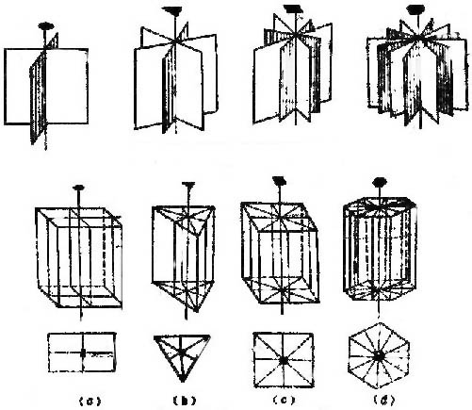
Combination of symmetry elements
Crystallography
Side
view
Top
view
Combination of L^{n} and P

Slide 50
Combination of symmetry elements
Crystallography
Theorem 4：L_{i}^{n} × P// = L_{i}^{n} ×L²⊥
→ L_{i}^{n}n/2 L²⊥ n/2 P// （n is even）
→ L_{i}^{n}n L²⊥ nP//（n is odd）

Slide 51
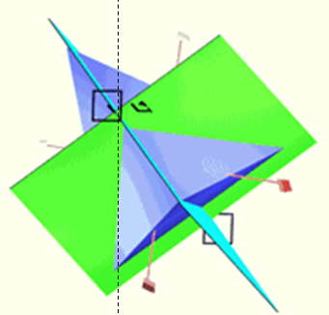
Combination of symmetry elements
Crystallography
e.g：tetragonal tetrahedron（四方四面体）can be generated by the following combination:
L_{i}⁴ × P// → L_{i}⁴2L² 2P
There are three pairs or totally six arrises. Each pair of arrises corresponds to a L². One L² has a higher symmetry L_{i}⁴ , so here two L² is given.

Slide 52

Example：粽子(Zongzi)
The symmetry is higher. All the three axes of regular tetrahedron(正四面体) are all L_{i}⁴

Slide 53
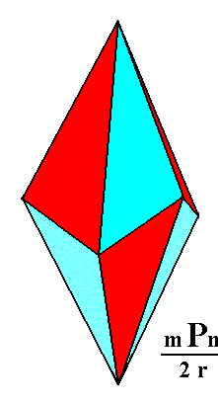
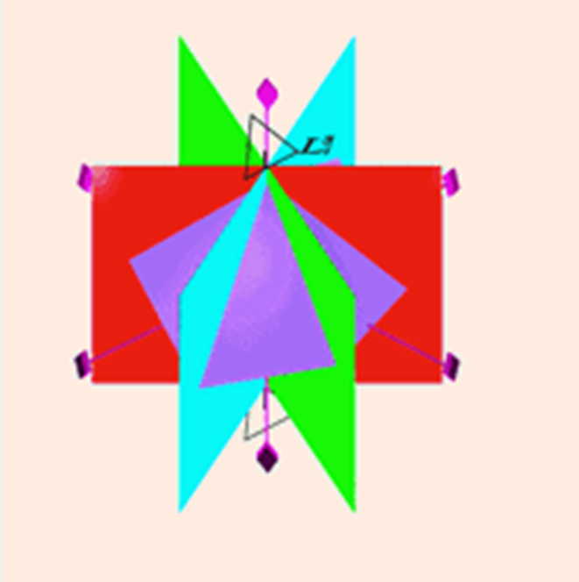
Combination of symmetry elements
Crystallography
Example：ditrigonal scalenohedron (复三方偏三角面体)
L_{i}³ × P// → L_{i}³3L² 3P
Exercise：to build up a paper model of the above polyhedron.

Slide 54
5. 32 classes of symmetry and their derivations
All the combination of symmetry elements are called class of symmetry or point group.
Generally, it is called class of symmetry when it emphasizes symmetry element, and called point group when emphasizes symmetry operation.
Notes:
Ⅰ.结合律成立，即对G中任意元素a,b,c都有 (a*b)*c=a*(b*c)；
Ⅱ.G中有元素e，叫做G的左单位元，它对G中每个元素a都有 e*a=a；
Ⅲ.对G中每个元素a在G中都有元素a^（-1），叫做a的左逆元，使 a^（-1）*a=e；
则称G对代数运算*做成一个群。
群：数学概念，集合和其上的一种运算构成一个群。群要求满足封闭性，存在单位元素，存在逆元素，满足该运算的结合律；简单说群是按照某种规律相互联系着的一组元素的集合。群的元素可以是字母、数字等，在晶体对称理论中，群的元素是对称操作。

Slide 55
5. 32 classes of symmetry and their derivations
Why called point group?
Because every symmetry element intersect at the crystal center, and the center does not move when carrying out symmetry operation. All the operations could form a group which agrees well with the concept of group in math, so it is called point group. The possible class of symmetry(point group) is only 32.
How are these 32 classes of symmetry derived?
Notes:
Ⅰ.结合律成立，即对G中任意元素a,b,c都有 (a*b)*c=a*(b*c)；
Ⅱ.G中有元素e，叫做G的左单位元，它对G中每个元素a都有 e*a=a；
Ⅲ.对G中每个元素a在G中都有元素a^（-1），叫做a的左逆元，使 a^（-1）*a=e；
则称G对代数运算*做成一个群。
群：数学概念，集合和其上的一种运算构成一个群。群要求满足封闭性，存在单位元素，存在逆元素，满足该运算的结合律；简单说群是按照某种规律相互联系着的一组元素的集合。群的元素可以是字母、数字等，在晶体对称理论中，群的元素是对称操作。

Slide 56
Group
Group：a math concept; a set and an operation on it to form a group.
Group requires the closure, the existence of unit elements, the existence of inverse elements, and the associative law.
Simply speaking, group is a set of elements that are interrelated by a certain law. Group elements can be letters, numbers, etc..
In crystal symmetry theory, elements are symmetry operations.
Notes:
Ⅰ.结合律成立，即对G中任意元素a,b,c都有 (a*b)*c=a*(b*c)；
Ⅱ.G中有元素e，叫做G的左单位元，它对G中每个元素a都有 e*a=a；
Ⅲ.对G中每个元素a在G中都有元素a^（-1），叫做a的左逆元，使 a^（-1）*a=e；
则称G对代数运算*做成一个群。
群：数学概念，集合和其上的一种运算构成一个群。群要求满足封闭性，存在单位元素，存在逆元素，满足该运算的结合律；简单说群是按照某种规律相互联系着的一组元素的集合。群的元素可以是字母、数字等，在晶体对称理论中，群的元素是对称操作。

Slide 57
Group
Group operations:
Ⅰ. Associative law: For any element a, b, c in G, there is (a*b)*c=a*(b*c)；
Ⅱ. There must be an element e, which is called the left unit of G. For every element a in G, there is e*a=a；
Ⅲ. For every element a in G, there is a^（-1），called the left inverse element of a， a^（-1）*a=e; G form a group based on the algebraic operations “*”.
Notes:
Ⅰ.结合律成立，即对G中任意元素a,b,c都有 (a*b)*c=a*(b*c)；
Ⅱ.G中有元素e，叫做G的左单位元，它对G中每个元素a都有 e*a=a；
Ⅲ.对G中每个元素a在G中都有元素a^（-1），叫做a的左逆元，使 a^（-1）*a=e；
则称G对代数运算*做成一个群。
群：数学概念，集合和其上的一种运算构成一个群。群要求满足封闭性，存在单位元素，存在逆元素，满足该运算的结合律；简单说群是按照某种规律相互联系着的一组元素的集合。群的元素可以是字母、数字等，在晶体对称理论中，群的元素是对称操作。

Slide 58
Crystallography
Derivation of A type class of symmetry
High axis (n>2) is no more than one
1) Individual symmetry axis L^{n}: possible symmetry class L¹, L², L³ , L⁴ , L⁶ ;
2) The combination of symmetry axises: Here we only consider the combination of a L^{n} and the L² that is perpendicular to L^{n} . According to L^{n}×L²⊥→L^{n}nL²，the possible class of symmetry：L¹L²=L², L²2L²=3L², L³3L², L⁴4L², L⁶6L².

Slide 59
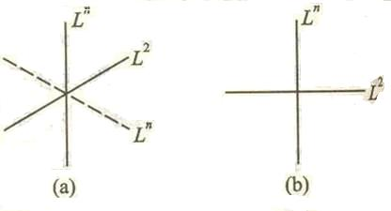
Crystallography
Derivation of A type class of symmetry
High axis (n>2) is no more than one
If L² skew L^{n}, a higher axis may form, then it does not belong to A type.

Slide 60
Crystallography
Derivation of A type class of symmetry
High axis (n>2) no more than one
3) Combination of L^{n} and the P that is perpendicular it.
Consider the combination law L^{n(even)} ×P⊥→L^{n(even)}PC，the possible class of symmetry：（L¹P=P）；L²PC；（L³P=L_{i}⁶）；L⁴PC；L⁶PC.
4) Combination of L^{n} and the P that contains it.
Consider the combination law L^{n} × P∥→L^{n}nP， the possible class of symmetry： （L¹P=P）; L²2P；L³3P；L⁴4P；L⁶6P.

Slide 61
Crystallography
Derivation of A type class of symmetry
High axis (n>2) no more than one
5) Combination of L^{n} and the P that is perpendicular it and the P that contains it.
The intersection between the P (perpendicular to L^{n} ) and the P (contains L^{n} ) must be the L² perpendicular to L^{n} .
L^{n} × P⊥ × P∥=L^{n} × P⊥ × P∥ × L²⊥ =L^{n}nL²(n + 1)P (C)
(C is generated only in the case of n is even ).
Notes:
L^{n} × P⊥ × P∥=L^{n} × P⊥ × P∥ × L²⊥ =L^{n}nL²(n + 1)P（C）; 这里n+1个P有n个来自于Ln和P//, +1来自于P⊥

Slide 62
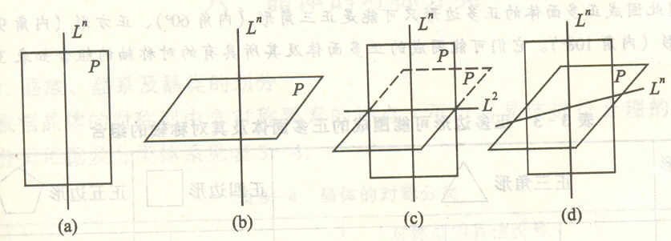
Crystallography
Derivation of A type class of symmetry
High axis (n>2) no more than one
The possible class of symmetry：
（L¹L²2P=L²2P); L²2L²3PC=3L²3PC;(L³3L²4P=L_{i}⁶3L²3P); L⁴4L²5PC; L⁶6L²7PC。
Notes:
L^{n} × P⊥ × P∥=L^{n} × P⊥ × P∥ × L²⊥ =L^{n}nL²(n + 1)P（C）; 这里n+1个P有n个来自于Ln和P//, +1来自于P⊥

Slide 63
Crystallography
Derivation of A type class of symmetry
High axis (n>2) no more than one
6) Rotoinversion axis. Possible class of symmetry：L_{i}¹=C；L_{i}²=P；L_{i}³=L³C；L_{i}⁴；L_{i}⁶=L³P。
7) Combination of L_{i}^{n} and L² perpendicular to it（or P which contains it）.
According to combination law，
when n is odd, L_{i}^{n}nL²nP，possible class of symmetry：（L_{i}¹L²P=L²PC）；L_{i}³3L²3P=L³3L²3PC；
when n is even L_{i}^{n}(n /2)L²(n /2)P， possible class of symmetry ：（L_{i}²L²P=L²2P）；L_{i}⁴2L²2P；L_{i}⁶3L²3P=L³3L²4P.

Slide 64
Combination of multiple high order axes 1. Primitive type：symmetry axis of tetrahedron 3L²4L³ 2. Center type：combination of primitive type and symmetry center 3L²4L³3PC 3. Axis type：combination of primitive type and symmetry axis 3L⁴4L³6L² 4. Plane type： combination of primitive type and symmetry plane 3L_{i}⁴4L³6P 5. Axial plane type：add symmetry plane on the base of axis type 3L⁴4L³6L²9PC
Crystallography
Derivation of B type class of symmetry
High axis (n>2) more than one

Slide 65
Crystallography
All the derived classes of symmetry is 32, as show in table below.
^{Combined type} | L^{n} | L^{n}nL² | L^{n} P(C) | L^{n} nP |  | L^{n} nL² (n+1)P(C) |  | L_{i}^{n} | L_{i}^{n} nL² nP L_{i}^{n} n/2L² n/2P
^{A} ^{type} | L¹ |  |  |  |  |  |  | L_{i}^{n} = C
 | L² | 3L² | L²PC | L² P |  | 3L² 3PC |  | L_{i}² = P
 | L³ | L³3L² |  | L³3P |  |  |  | L_{i}³ =L³ C | L³3L² 3PC
 | L⁴ | L⁴4L² | L⁴PC | L⁴4P |  | L⁴ 4L² 5PC |  | L_{i}⁴ | L_{i}⁴ 2L² 2P
 | L⁶ | L⁶6L² | L⁶PC | L⁶6P |  | L⁶ 6L² 7PC |  | L_{i}⁶ =L³ P | L_{i}⁶ 3L² 3P = L³ 3L² 4P
^{B type} |  | 3L²4L³ | 3L⁴ 4L³6L² |  | 3L² 4L³3PC |  | 3 L_{i}⁴ 4L³6P |  | 3L⁴ 4L³ 6L² 9PC
Conventional symbol of point group

Slide 66
6. Classification of crystal symmetry
Crystallography
1) The divisions of crystal category, crystal system and crystal class, see table 3-4
Division of crystal category
According to the number of high axis, the crystal can be divided into 3 crystal categories.
higher category (高级晶族)
intermediate category (中级晶族)
lower category (低级晶族)

Slide 67
Classification of crystal symmetry
Crystallography
Division of crystal system
According to the level or number of symmetry axis or roto-inversion axis, it can be divided into 7 crystal systems, which belongs to 3 crystal categories.
isometric system (等轴晶系) or cubic system (立方晶系)
hexagonal system (六方晶系)
tetragonal system (四方晶系)
trigonal system (三方晶系)
orthorhombic system (斜方晶系, 亦称正交晶系)
monoclinic system (单斜晶系)
triclinic system (三斜晶系)
High
Medium
Low
Notes:
立方（等轴）晶系；
正方（四方）晶系；
六角 (六方）晶系；
三角（三方，菱方）晶系；
正交（斜方）晶系；
单斜晶系；
三斜晶系。

Slide 68
Classification of crystal symmetry
Crystallography
Table 3－4 --- the below and next page
Above are the international symbol of point group，why some of them have centers , some does not have?
Notes:
三方和六方晶系有些时候简并成一个晶系。

Slide 69
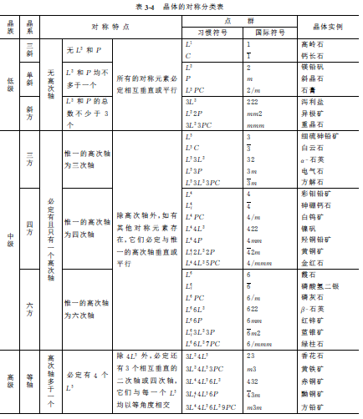

Slide 70
7. Symmetry symbols of point group
Symbol of symmetry elements (three kinds)
Symbol of point group (three kinds)
Conventional symbol （常用符号）
International symbol （国际符号）
St. Frances symbol

Slide 71
Symbol of symmetry elements
Crystallography
Symmetry elements of the compound
Symmetrical elements of macroscopic crystals
Element
Symmetry Axis （n）
Symmetry center
Symmetry plane
Rotoinversion axis
-
-
-
1
2
3
4
6
3
4
6
Auxiliary geometry
line
point
plane
Line and certain point on the line
Symmetry operation
Rotation about lines
Inversion about point
Reflection about plane
Rotation about the line and inversion about the point
Basic rotation
angle
Conventional sign
-
-
-
International sign
Equivalent element
Graphical symbol
Or
Double line or thick line
There are three kinds of symbols for symmetry elements: Conventional symbol, international symbol, and graphical symbol (table 7-1 in textbook);

Slide 72
Crystallography
Conventional symbol of symmetry class (point group，点群）
3L⁴ 4L³ 6L² 9PC
The conventional symbol of symmetry class :
It shows all the symmetry elements；
Easy to understand；
It does to shows directions of symmetry elements.

Slide 73
International symbol of symmetry class (point group，点群）
Crystallography
m3m–3L⁴ 4L³ 6L² 9PC
The international symbol of symmetry class is simple:
It does not show all the symmetry element；
It shows directions of symmetry elements；
Hard to understand.
All the derived elements have been omitted.

Slide 74
International symbol of symmetry class
Crystallography
Symmetry axis shown as 1，2，3，4，6;
Symmetry plane shown as m；
Rotoinversion axis shown as 1、2、3、4、6, if the symmetry plane is perpendicular to symmetry axis，then these two are separated by stripping or diagonal (斜线或者横线）, such as L²PC shown as 2/m，L⁴PC shown as 4/m (then symmetry center C does not have to be shown, because the even axis perpendicular to symmetry plane must generate a C).

Slide 75
1. Set three serial positions (up to three), each position defines the direction of symmetry elements; 2. For symmetry elements with symmetrical meaning are in the same direction, no matter how much, just write one. 3. For different crystal systems, the directions of represented by the three serial number are completely different, so the writing of international symbols is completely different. The writing of international symbol for every crystal system is shown in the table below:
Crystallography
The writing of international symbol of point group is:

Slide 76
Crystallography
International symbol of point group
1
2
3
4/mmm
Tetragonal
Table 4-2：
Crystal class
3 directions
1
2
3
1
2
3
Isometric
c
a+b+c
a+b
[001]
[111]
[110]
Tetragonal
c
a
a+b
[001]
[100]
[110]
Rhombohedral
a
b
c
[100]
[010]
[001]
Monoclinic
b
[010]
Triclinic
Any direction
Any direction
Hexagonal
c
a
2a+b
[001]
[100]
[210]
Notes:
？？？
7大晶系、32点群是通过晶体空间点阵的宏观对称性8种基本对称操作来确定的，晶系的概念比较宽泛，主要由点阵的几何特征得出。 32种点群是8种对称操作元素组合的结果，1个晶系里可以有多个点群。如三斜晶系里有1、ī两种点群。 32种点群通过微观对称性（平移、螺旋、滑移反映）扩展出320种空间群，1个点群可以扩展为几个空间群。

Slide 77
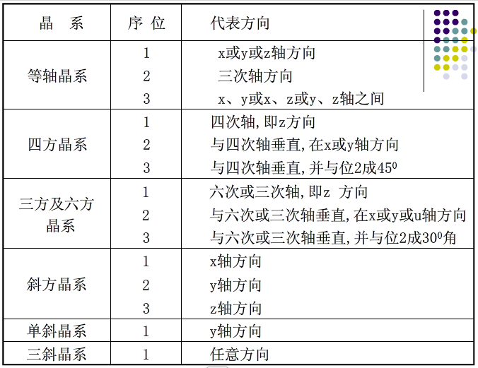

Slide 78
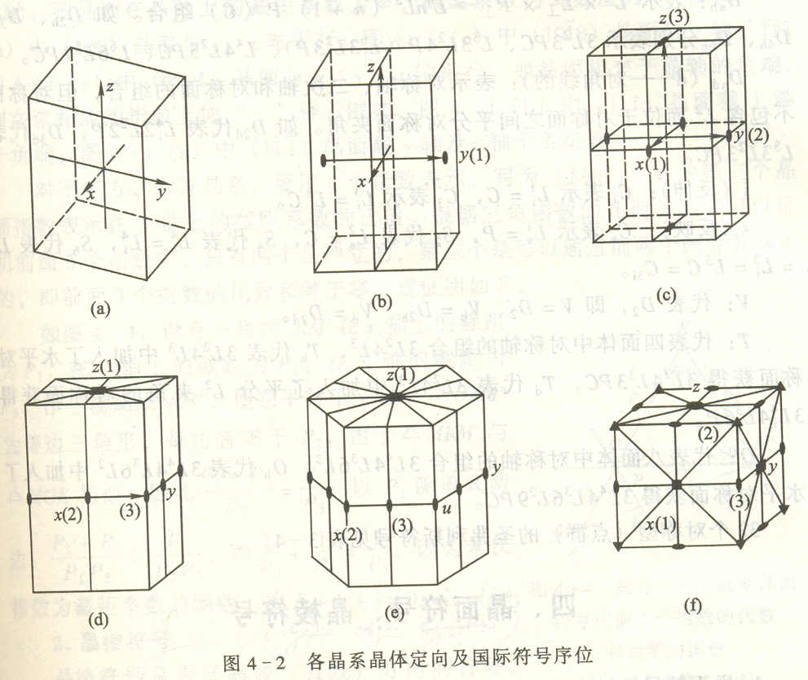
Coordination system establishment of crystal systems
triclinic
monoclinic
Rhombohedral
Tetragonal
Cubic
Hexagonal

Slide 79
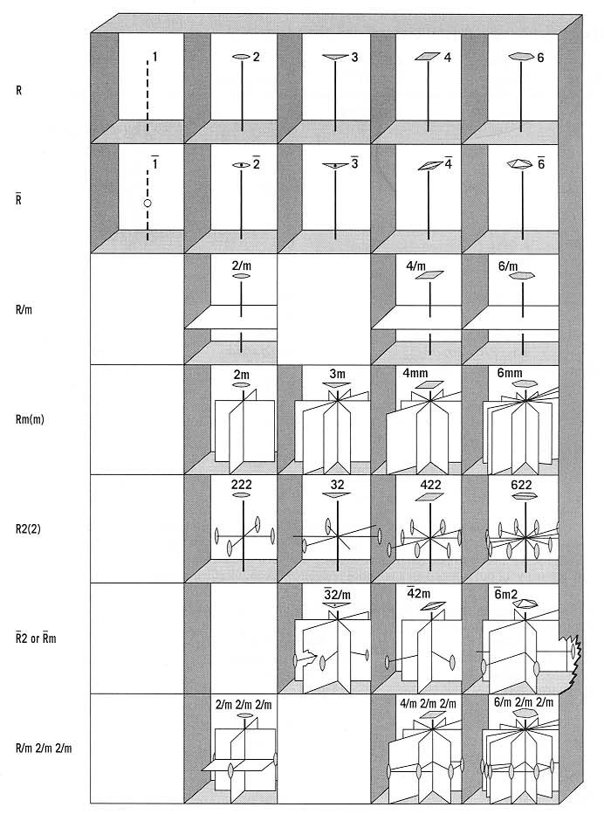
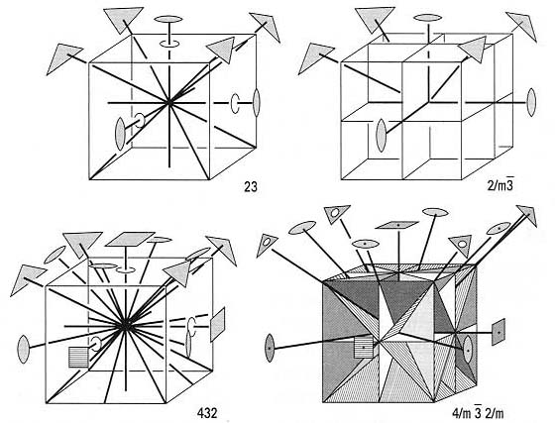
Point group symbols and their symmetric icons
Crystallography
Notes:
差一个m

Slide 80
3． St. Frances symbol of symmetry class
Crystallography
Saint-Frances symbol is based on several basic laws of symmetry element combination . Different letters are used to represent the basic combination of symmetric elements.
C_{n}——represents the alone existence of L^{n}，such as L¹、L²、L³、
L⁴、L⁶ are shown as C_{l}，C₂、C₃、C₄、C₆.
C_{nh}——represents L^{n}×P⊥=L^{n}P(C). such as P、L²PC、 L³P(L_{i}⁶)、 L⁴PC、 L⁶PC are represented as C_{lh}、C_{2h}、C_{3h}、 C_{4h}、 C_{6h}.

Slide 81
St. Frances symbol of symmetry class
Crystallography
C_{nv}——represents L^{n}×P∥=L^{n}nP ，such as L²2P、 L³3P、L⁴4P、L⁶6P are represented as C_{2v}、C_{3v}、C_{4v}、 C_{6v}.
D_{n}——represents L^{n}×L²⊥= L^{n}nL²，such as L²2 L² (3L²)、L³ 3 L² 、L⁴4 L²、 L⁶6L² are represented as D₂、D₃、D₄、D₆.
D_{nh}——represents L^{n}×L²⊥×P⊥= L^{n}nL²(n+1)P(C)， such as 3L²3PC、L³ 3 L²4P（L_{i}⁶3L²3P）、L⁴4 L²5PC、 L⁶6L²7PC are represented as D_{2h}、D_{3h}、D_{4h}、 D_{6h}.
D_{nd}——represents the symmetry plane does not contain L²，but at the position of equally divided L²，such as L_{i}⁴2L²2P、L³3L²3PC are represented as D_{2d}、D_{3d}.

Slide 82
St. Frances symbol of symmetry class
Crystallography
i——represents rotoinversion，such as C_{i} represents onefold rotoinversion axis which equals to symmetry center C，C_{3i} represents threefold rotoinversion axis L_{i}³ which equals to L³C.
S——represents rotoreflection，such as C_{s} represents L_{s}¹=P=C_{lh}；L_{s}²=C=C_{i}。S₄ represents L_{s}⁴ =L_{i}⁴，S₆ represents L_{s}⁶=L³C
D₂ is represented by V，V= D₂、V_{h}= D_{2h}、V_{d}= D_{2d}.

Slide 83
St. Frances symbol of symmetry class
Crystallography
T——represents the combination of symmetry axes in tetrahedron 3 L²4 L³。
T_{h}——represents 3L²4L³3PC obtained by adding horizontal symmetry plane 3L²4L³.
T_{d}——represents 3L_{i}⁴4L³6P obtained by adding diagonal (the direction equally dividing L²) symmetry plane 3L²4L³。
O——represents a combination of symmetry axes in octahedron 3L⁴4L³6 L².
O_{h}——represents 3L⁴4L³6L²9PC obtained by adding horizontal symmetry plane 3L⁴4L³6 L².

Slide 84
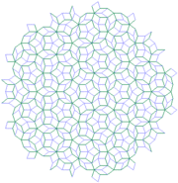
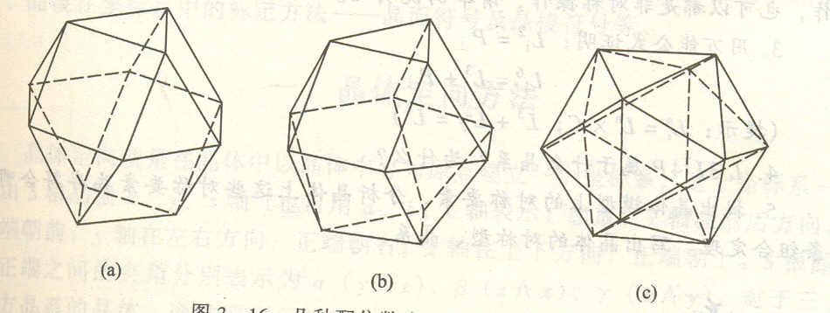
7. Classification of quasi-crystal
Self learning

Slide 85
Summary of key points：
Symmetry elements：P, L^{n}, C, L_{i}^{n}；
Combination of symmetry elements ：4 theorems；
Class of symmetry：how to judge by using combination theorem；
Classification of crystal symmetry: 3 crystal category，7 crystal systems，32 crystal classes（point group）；
International symbol of symmetry class and St. Frances symbol

Slide 86
Homework
All the examples and exercises；
All the proof question in the lecture .

Slide 87

同学们，再见！

